Slide 1
Hashing
Course Code: CSC 2106
Course Title: Data Structure (Theory)
Dept. of Computer Science
Faculty of Science and Technology
Lecture No: |  | Week No: |  | Semester:
Lecturer: | Email:

Slide 2
Lecture Outline
Hashing
Hashing Table
Division Hashing
Collision
Linear Probing

Slide 3
HASHING
Hashing:
Hashing is a technique to map data to a fixed-size value (hash code).
Used to quickly locate or retrieve data in a collection.
A hash function converts a key into an integer (hash code).
Applications: Databases, Cryptography, Caching.

Slide 4
Real-Life Examples of Hashing
1. Library Indexing: Quickly find books by genre.
2. Login Systems: Hash passwords for security.
3. URL Shortening: Long URLs become short unique strings.
4. Banking Transactions: Account numbers hashed for efficiency.

Slide 5
HASHING TABLE
Hash Table:
A data structure that stores data in key-value pairs.
Uses a hash function to compute an index for storage.
Provides fast access, insertion, and deletion of data.
Average time complexity: O(1).

Slide 6
What is Division Hashing
Hash(Key) = Key % Prime_Number or Table Size or Any Number
Prime numbers reduce clustering and improve distribution.
Example:
Keys: {10, 22, 31}, Prime: 7
Results:
10 % 7 = 3
22 % 7 = 1
31 % 7 = 3 (collision)

Slide 7
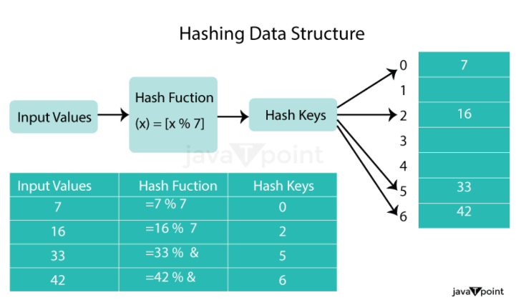
Hashing Data structure

Slide 8
COLLISION
Collision:
Occurs when two or more keys map to the same hash index.
Needs to be resolved to store all keys.
Common resolution techniques:
- Separate Chaining
- Open Addressing (e.g., Linear Probing, Quadratic Probing).

Slide 9
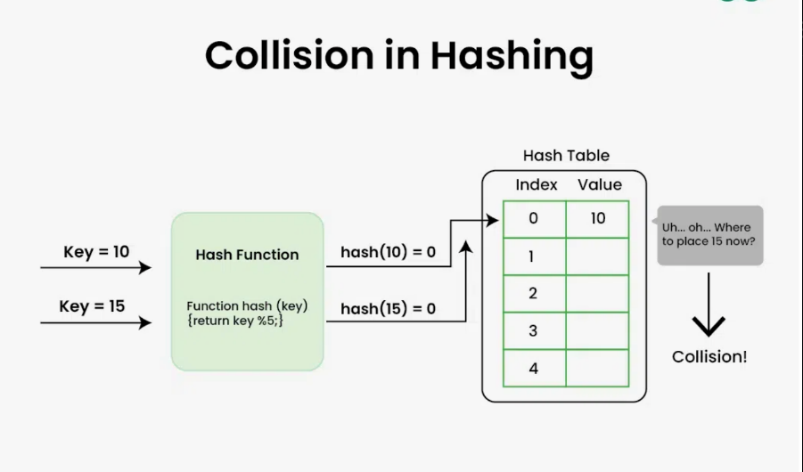

Slide 10
LINEAR PROBING
Linear Probing:
Collision resolution technique in Open Addressing.
If a collision occurs, checks next available slot linearly:
h'(k, i) = (h(k) + i) mod m
Advantages:
- Simple to implement.
Disadvantages:
- May cause clustering and degrade performance as the table fills.

Slide 11
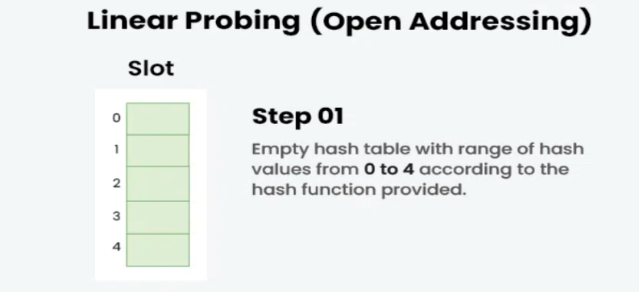
Example
Keys: {50, 70, 76, 85, 93}

Slide 12
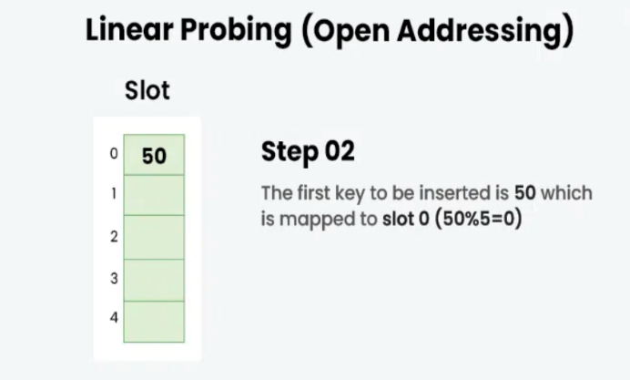

Slide 13
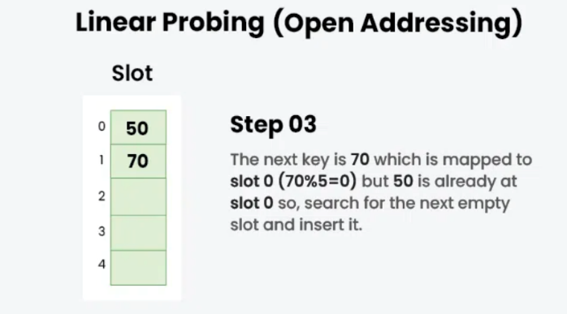

Slide 14
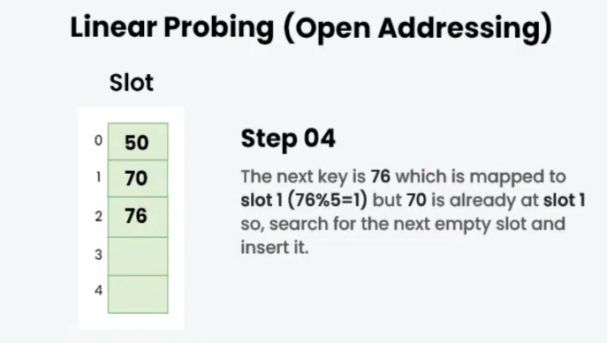

Slide 15
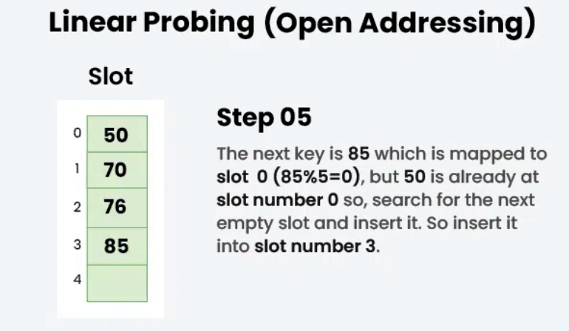

Slide 16
